Slide 1

RISC-V FPGA for Computer Vision Applications
Tutorial 2: Porting RISC-V and FreeRTOS on IGLOO2
EE 297A/B
Friday, September 4, 2020
Project Members:
Anee Mineshkumar Dubhia^{[1]}
Chee Vang^{[2]}
Advisor:
Professor Harry Li, Ph. D.^{[3]}

Slide 2
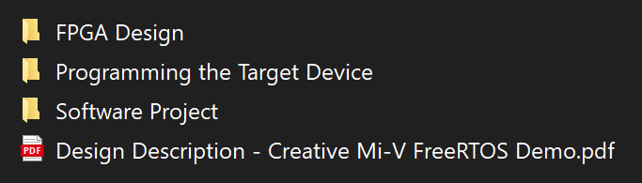
Step 1 Download and Unzip Demo project
Clone github repository of the demo project from https://github.com/Future-Electronics-Design-Center/Creative-Eval-Board
Go to IGL2_MiV_FreeRTOS_Demo folder
Unzip the files in the folders
FPGA Design – Project used in Libero SoC IDE
Software Project – Project used in SoftConsole IDE
Fig. 1. Items in the directory IGL2_MiV_FreeRTOS_DEMO

Slide 3
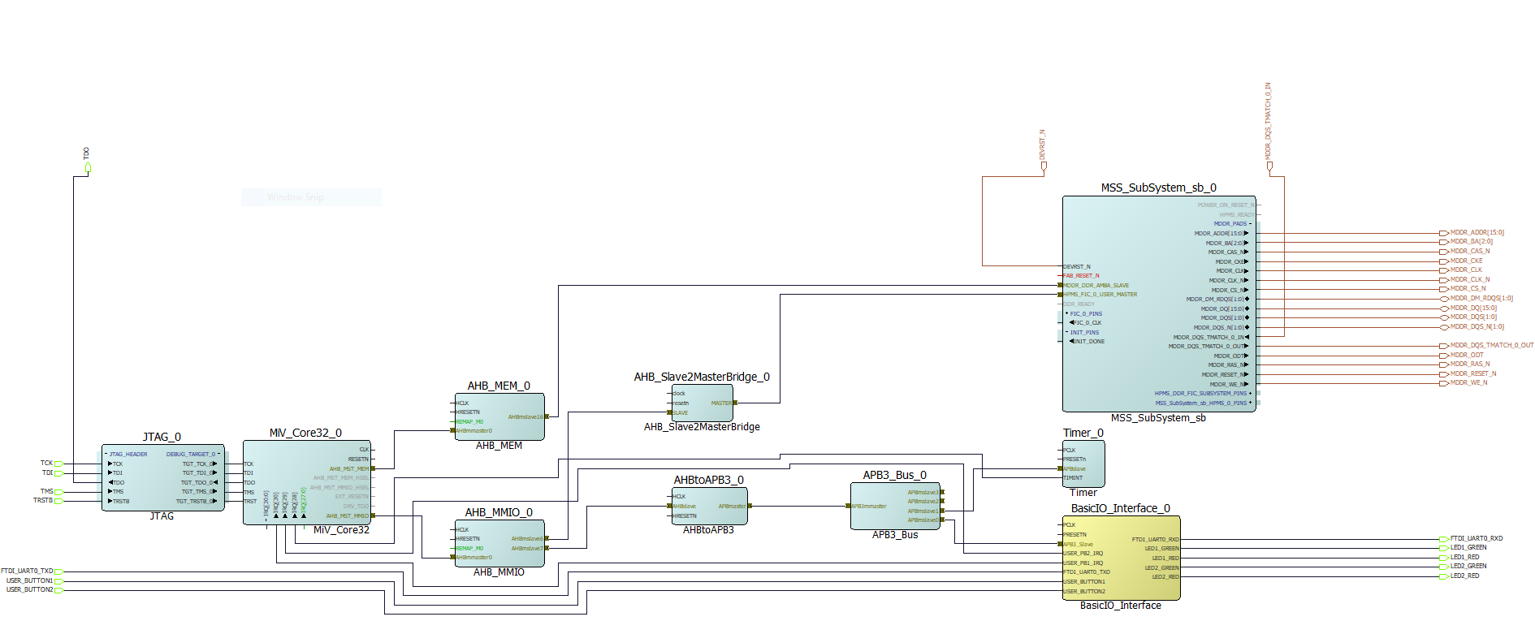
SmartDesign
Cortex-M3 process, which is configure for MSS
Offers four Fabric Interface Controller (FIC):
DDR_FIC
Used when you configureMSS DDR block (MDDR) such that external DDR memory can be accessed from FPGA fabric master via AXI or AHBLite
SMC_FIC
Used when you configure MSS DDR Block in Single Date Rate (SDR) mode
FIC_0 and FIC_1 (depending on device)
These interface blocks enable MSS to interface with logic implementation in FPGA fabric and vice versa

Slide 4
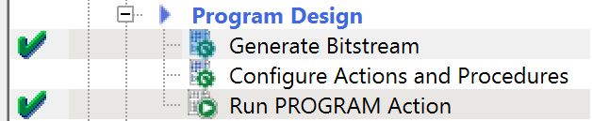
Step 2 Open Project in Libero SoC IDE
Open Libero SoC IDE (Download: https://www.microsemi.com/product-directory/design-resources/1750-libero-soc#downloads)
Click on Open Project
Select project file from FPGA Design > IGL2_MiV_FreeRTOS_Demo > IGL2_MiV_FreeRTOS_Demo.prjx
In Design Flow, double-click Generate Bitstream
Double-click Run PROGRAM Action
7
8
Fig. 2. Successful generation and upload of design

Slide 5
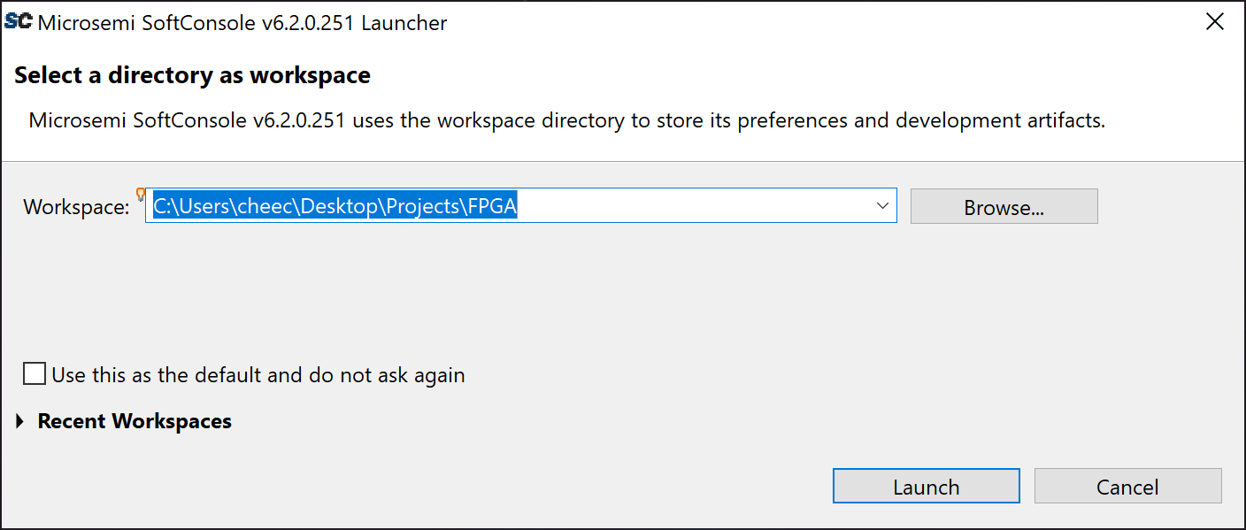
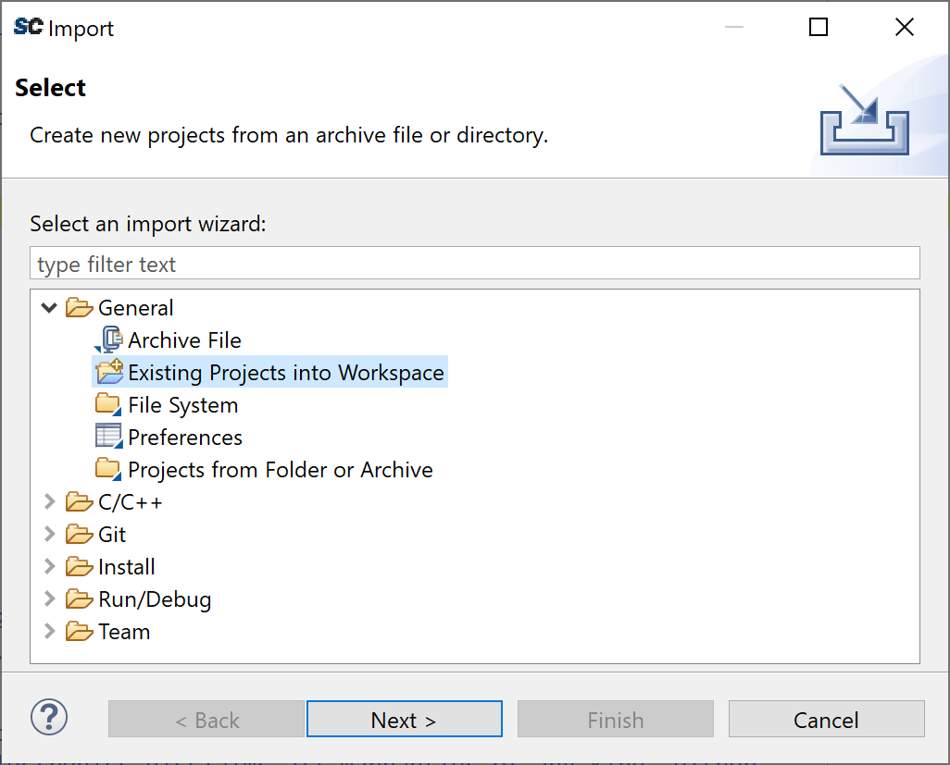
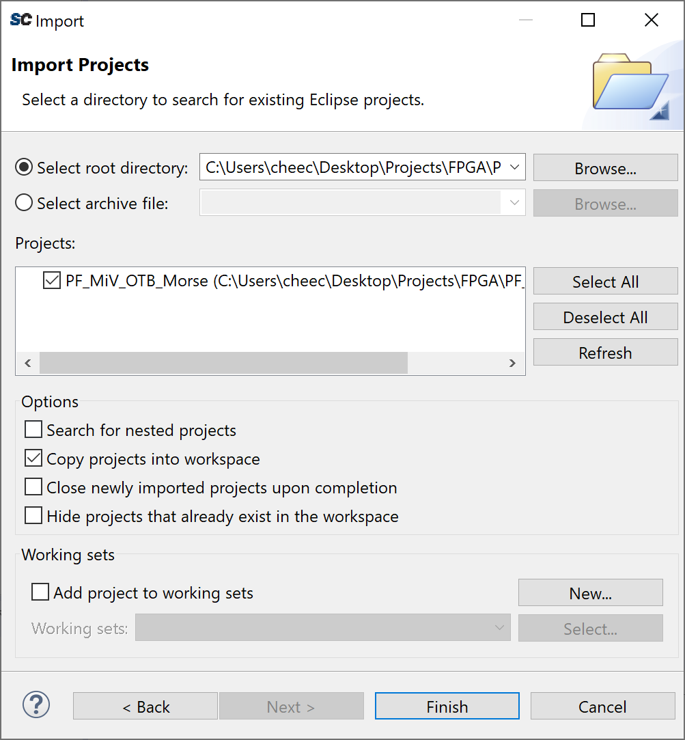
Step 3 Import Project in SoftConsole IDE
Open SoftConsole IDE (Click on Browse to choose a workspace.
Click Launch.
Import demo Project by going to File > Import
Choose General > Existing Projects into Workspace.
Click Next
Click on Browse and select unzipped folder contained in Software Project
In Projects, check PF_MiV_OTB_Morse.
Uncheck all options except Copy projects into workspace.
Click Finish.
9
10
Fig. 3. Selecting the workspace
14
12
15
16
13
Fig. 4. Importing exiting project into workspace
17
Fig. 5. Importing existing project (continued)

Slide 6
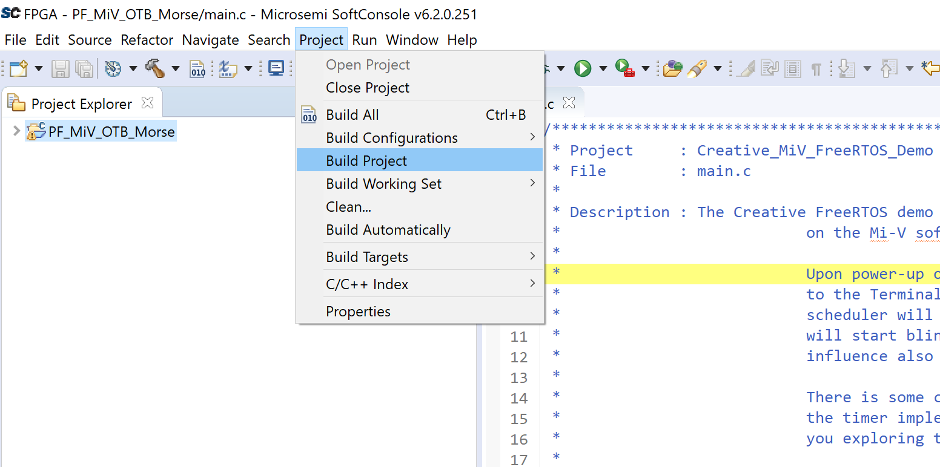
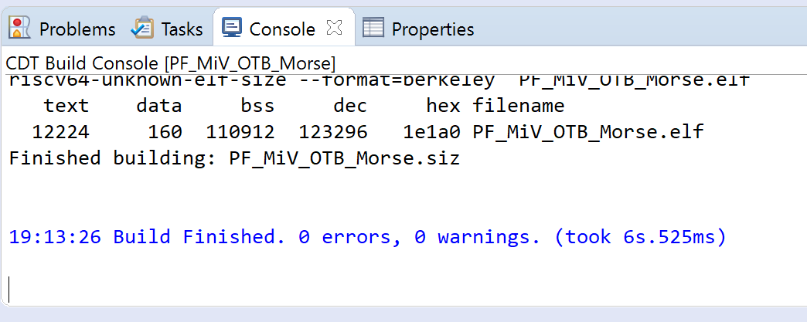
Step 4 Build Project
Select PF_MiV_OTB_Morse in Project Explorer.
Build the project by going to Project
Select Build Project.
In Console window, it should say that there are zero errors and zero warnings.
20
19
21
Fig. 6. Select the project and build
Fig. 8. Successful build of demo project

Slide 7
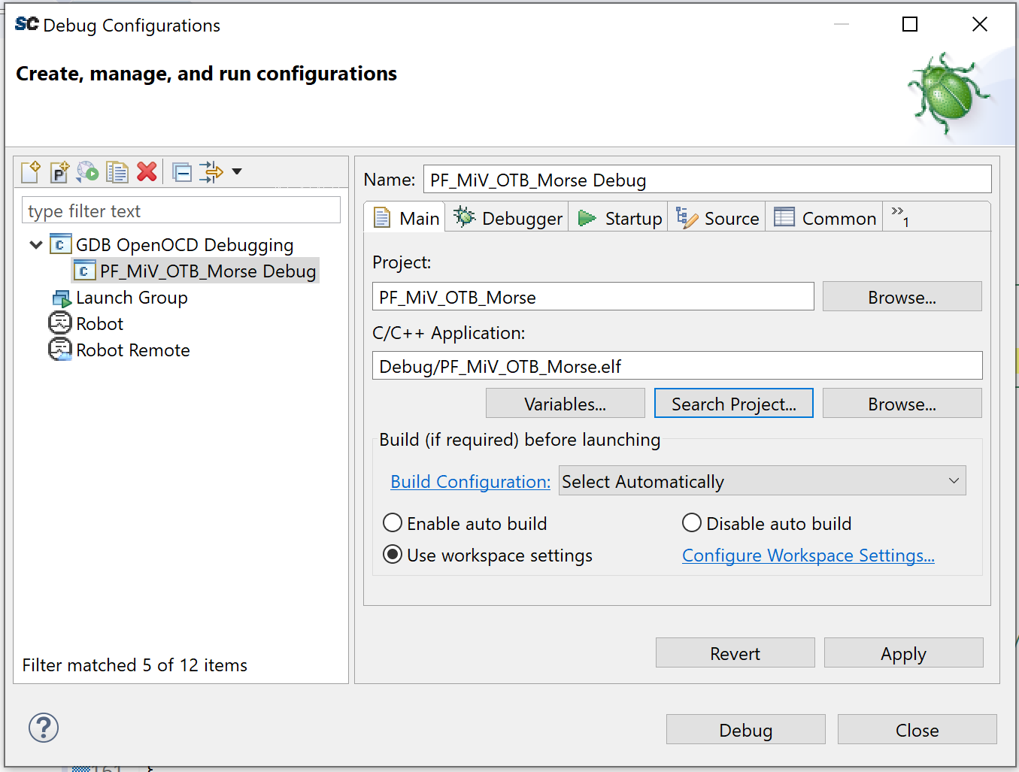
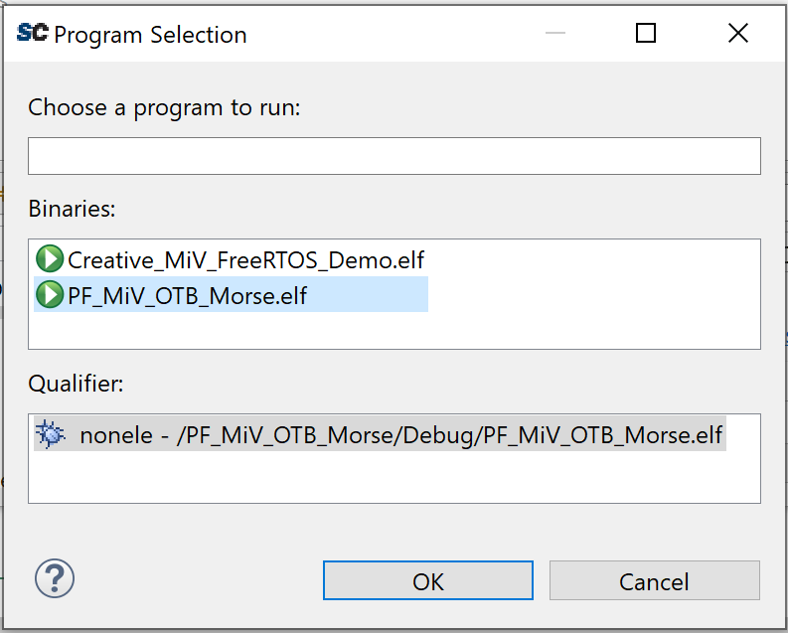
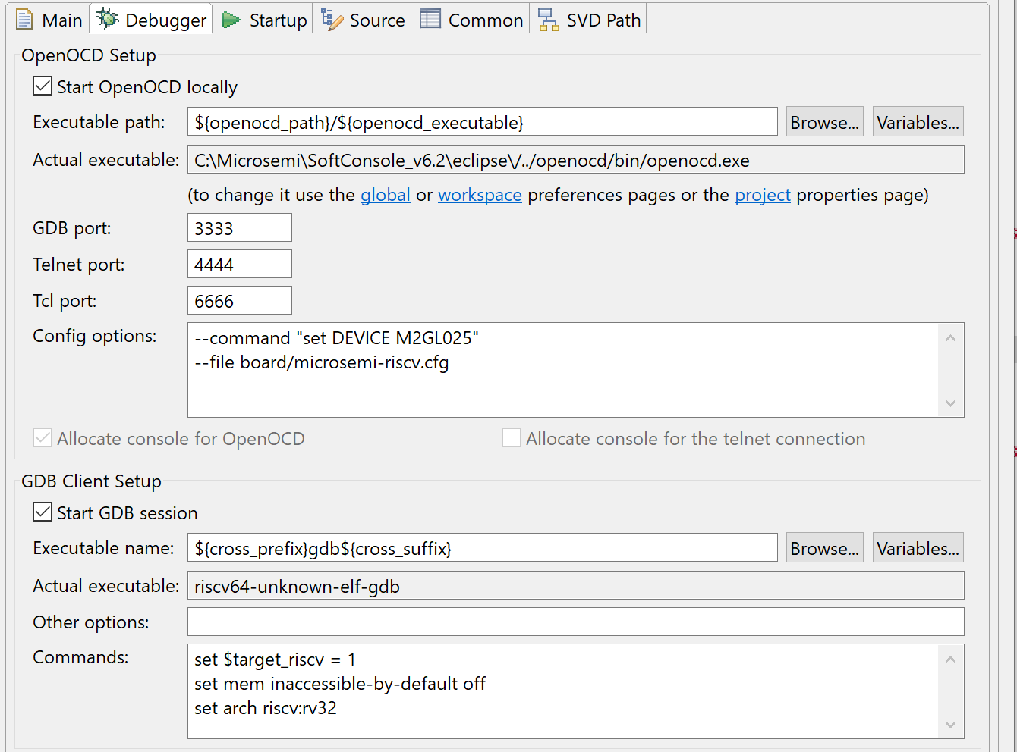
Step 5 Debug Configurations
Go to Run > Debug Configurations.
Double-click on GDB OpenOCD Debugging.
In Main, click on Search Project.
Choose PF_MiV_OTB_Morse.elf.
Click OK.
In Debugger, add to Config Options:
--command “set DEVICE M2GL025”
--file board/Microsemi-riscv.cfg
Also add to Commands:
set $target_riscv = 1
set mem inaccessible-by-default off
set arch riscv:rv32
25
24
26
Fig. 8. Program Selection
Fig. 7. Main tab in Debug configuration
27
28
Fig. 9. Debugger tab in Debug configuration

Slide 8
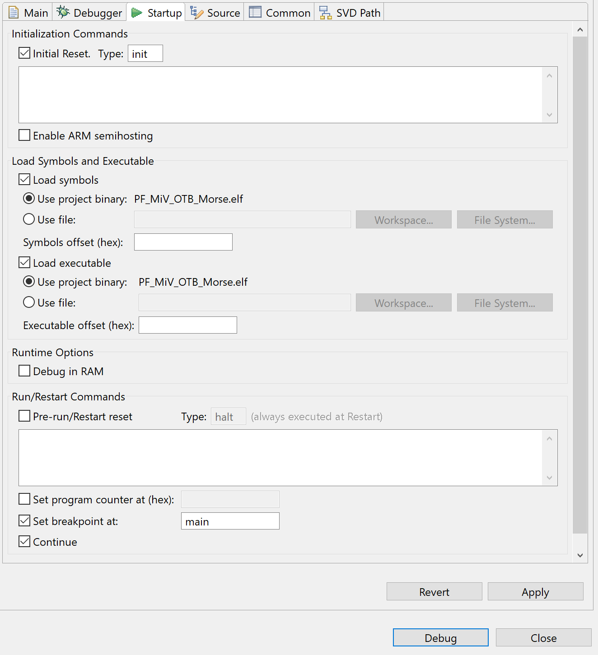
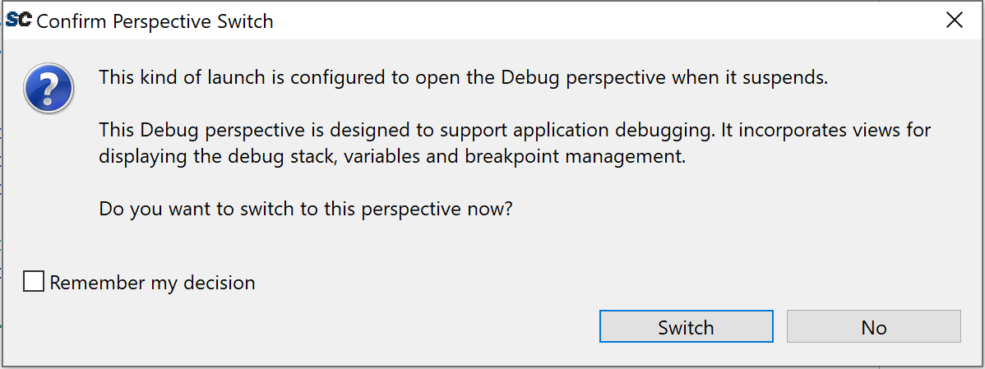
Step 6 (Continued) Debug Configurations
In Startup, uncheck Enable ARM semihosting.
Uncheck Pre-run/Restart reset.
Click Apply.
Click Debug.
Click on Switch to go to debug perspective.
No errors should appear and the program will be paused.
29
30
31
32
33
Fig. 10. Startup tab in Debug configuration
Fig. 11. Prompts user to switch to debug perspective

Slide 9
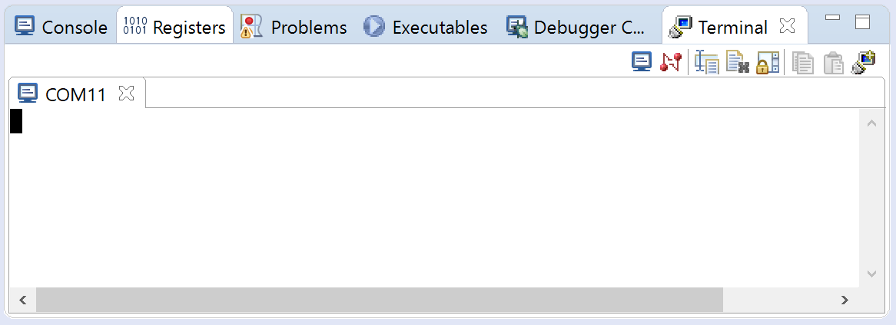
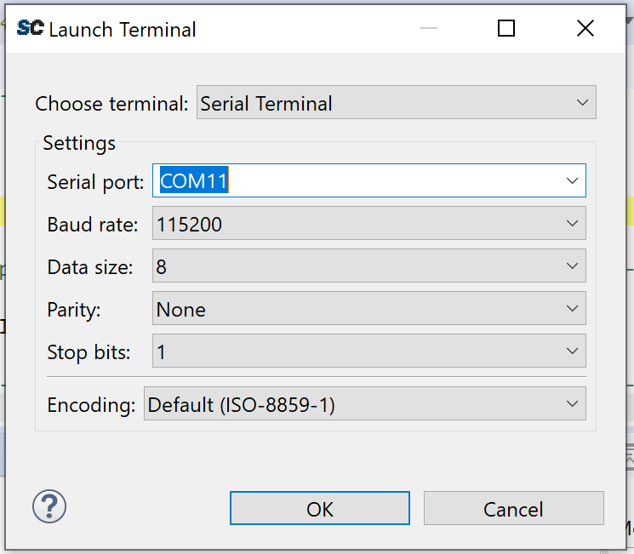
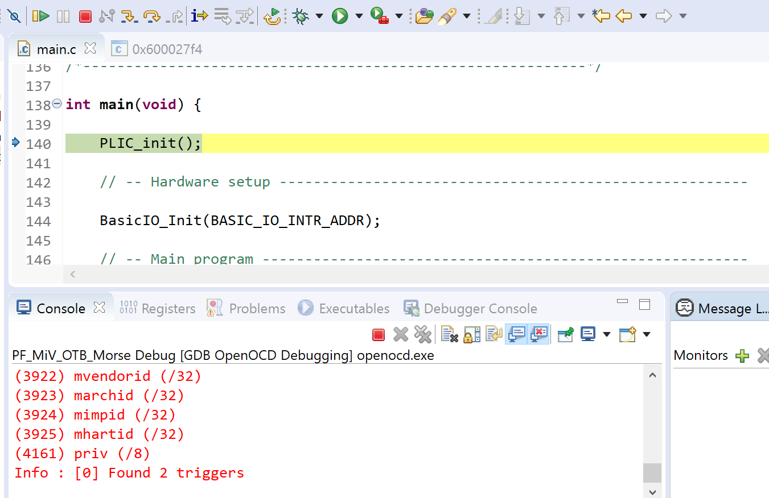
Step 7 Debugging
Open terminal window from Window > Show View > Terminal.
Click on Open a Terminal button.
In Launch Terminal, choose Serial Terminal.
For Serial port, select the correct port found in Device Manager, labeled as FlashPro5 Port.
Click OK.
Resume debugging by clicking on Resume button.
36
Fig. 12. Terminal window with COM11 connected
37
38
39
40
Fig. 13. Terminal settings
Fig. 14. SoftConsole debugging toolbar

Slide 10
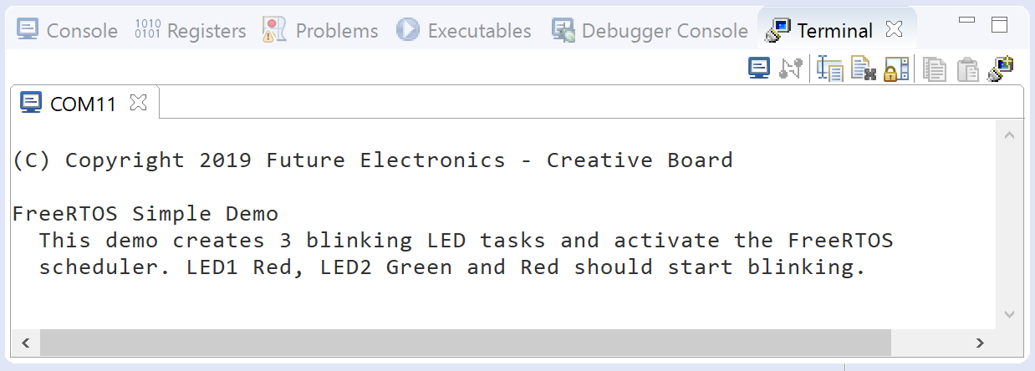
Step 8 Program Running On IGLOO2
A description of the demo project will appear in the terminal and the onboard LEDS will blink at different times.
Fig. 15. Message echoed back from FPGA once the program is resumed
(Video)

